Slide 1



Visio-Linguistic Brain Encoding
August 13, 2022
COLING 2022
Subba Reddy Oota^{1,2}, Jashn Arora², Vijay Rowtula², Manish Gupta^{2,3}, Bapi Raju Surampudi²
¹Inria Bordeaux France, ²IIIT-Hyderabad, ³Microsoft India

Slide 2
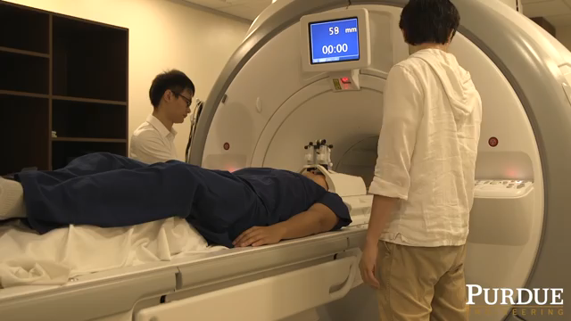
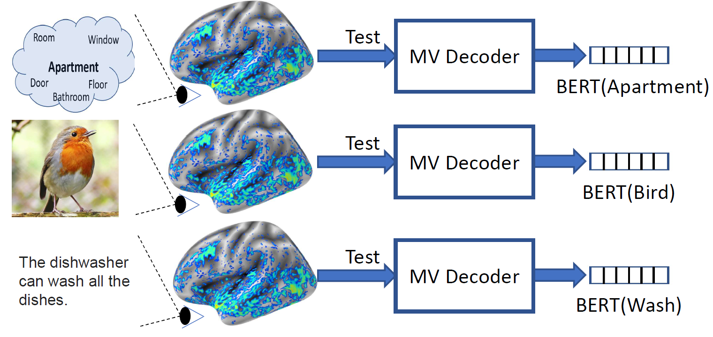
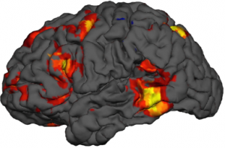
What is fMRI?
A vision-language task in the scanner
Concept + Picture
fMRI Brain Activity
https://www.biopac.com/events/fmri-psych/

Slide 3
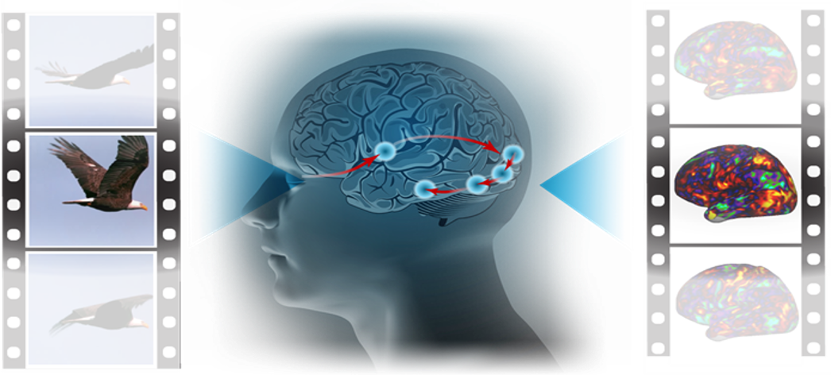
Brain Encoding vs Decoding
Stimulus
Representation
Encoding
fMRI
Concept + Picture
Stimulus
Representation
Decoding
fMRI
Haiguang Wen et al, 2017

Slide 4
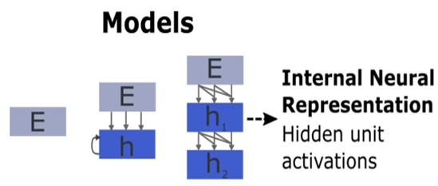
What is Brain Encoding?
Stimulus
Present
Schrimpf et al. 2021 fMRI

Slide 5
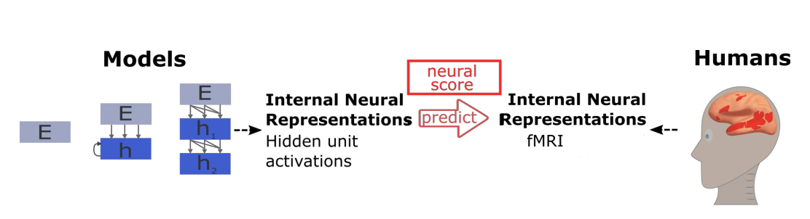
What is Brain Encoding?
Stimulus
Stimulus
Present
Present
Schrimpf et al. 2021 fMRI

Slide 6
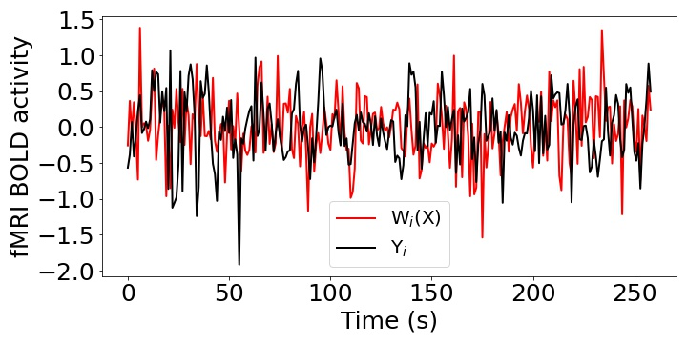
What is Brain Encoding?
Pearson Correlation (R) = Corr(Y, W(X))
Stimulus
Stimulus
Present
Present
X
W
Y
Input
Ridge Regression
Output
Schrimpf et al. 2021

Slide 7
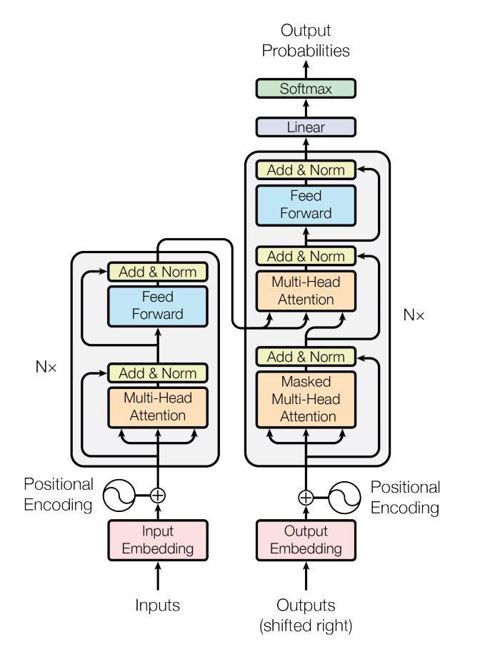
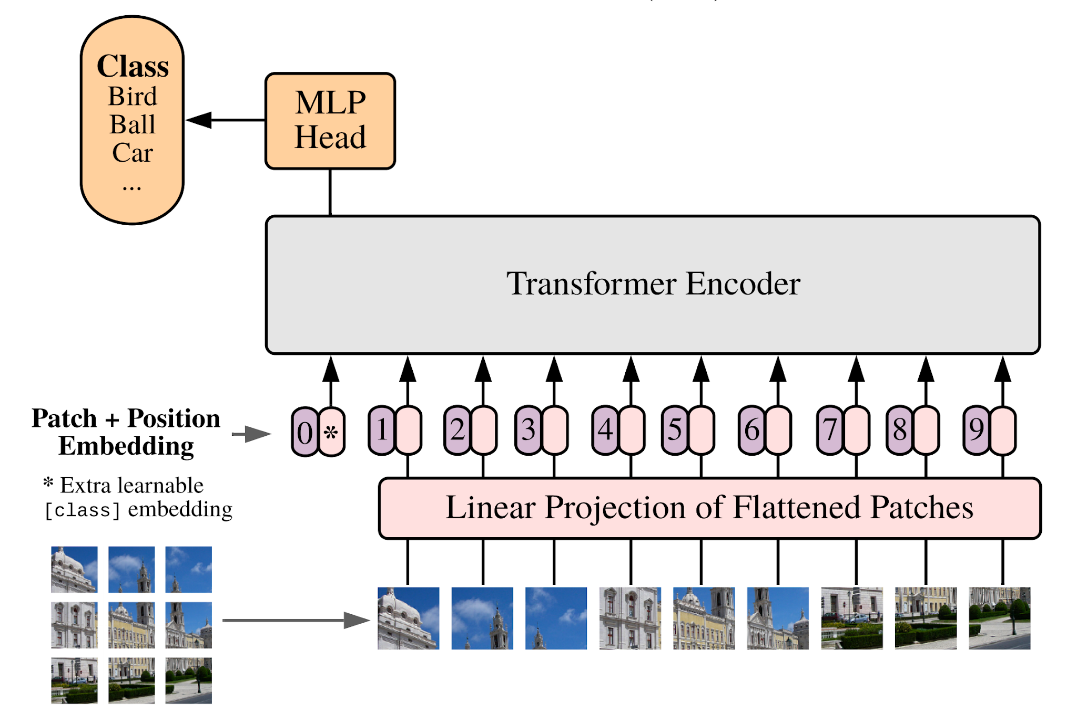
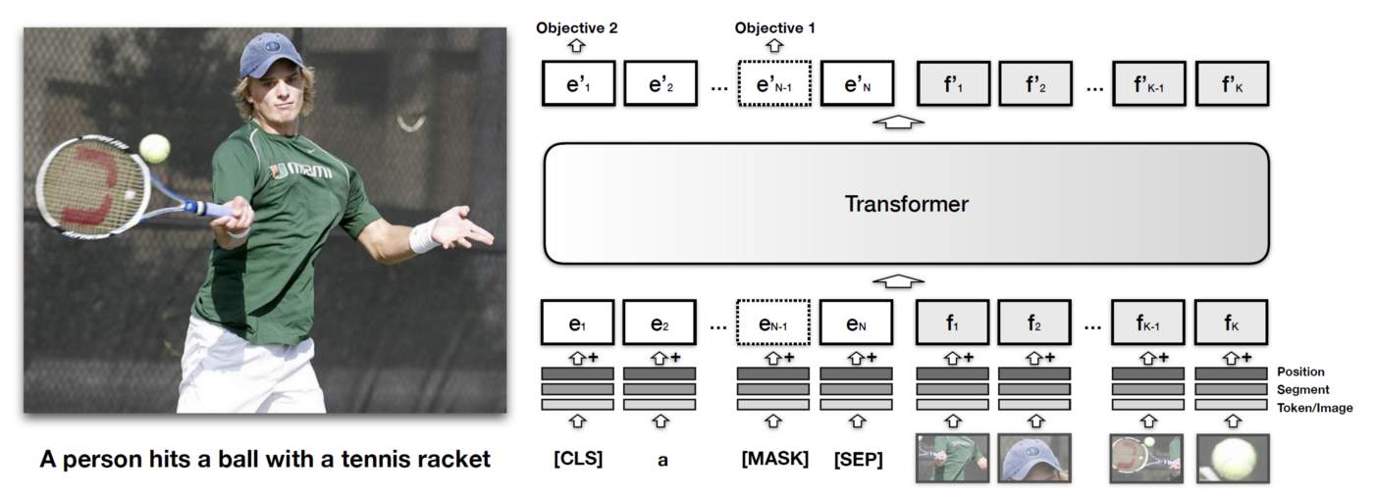
Most popular models are Transformers
Transformer language models
Vision Transformer (ViT)
Multi-modal Transformer
Vaswani et al. 2017, Dosovitskiy et al. 2021, Harold Li et al. 2019
Notes:
Transformer based models like BERT ( have been found to be very effective across a large number of natural language processing (NLP) tasks.

Slide 8
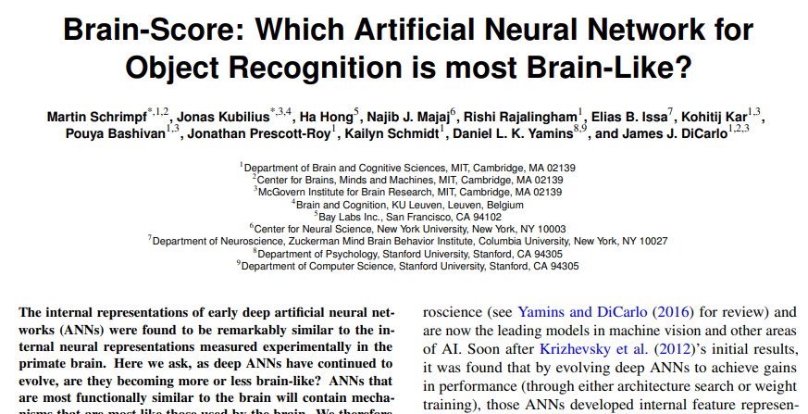
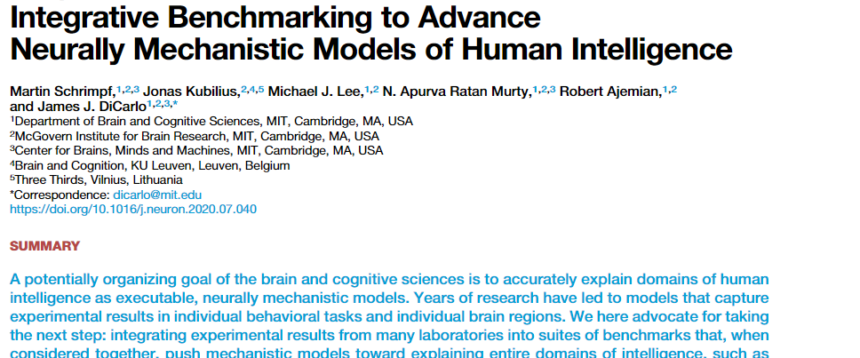
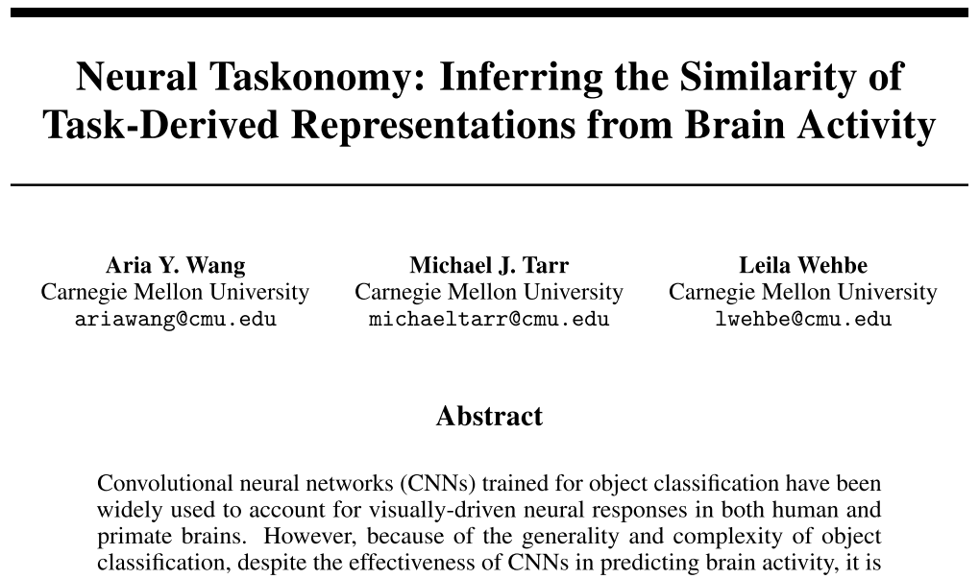
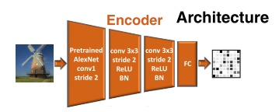
Brain encoding for single-mode stimuli: Vision
Shrimpf et al. 2019, Shrimpf et al. 2019, Wang et al. 2019
Notes:
Therefore, the next logical step is to see which of these Transformer representations most effectively drive the linear mapping between language models and the brain in the context of NLP tasks.
Gauthier and Levy (2019) fine-tune a pretrained BERT model on multiple tasks to find tasks best correlated with high decoding performance.

Slide 9
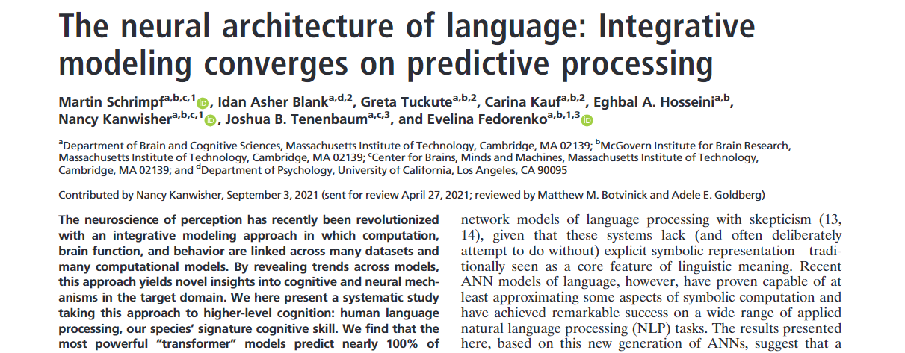
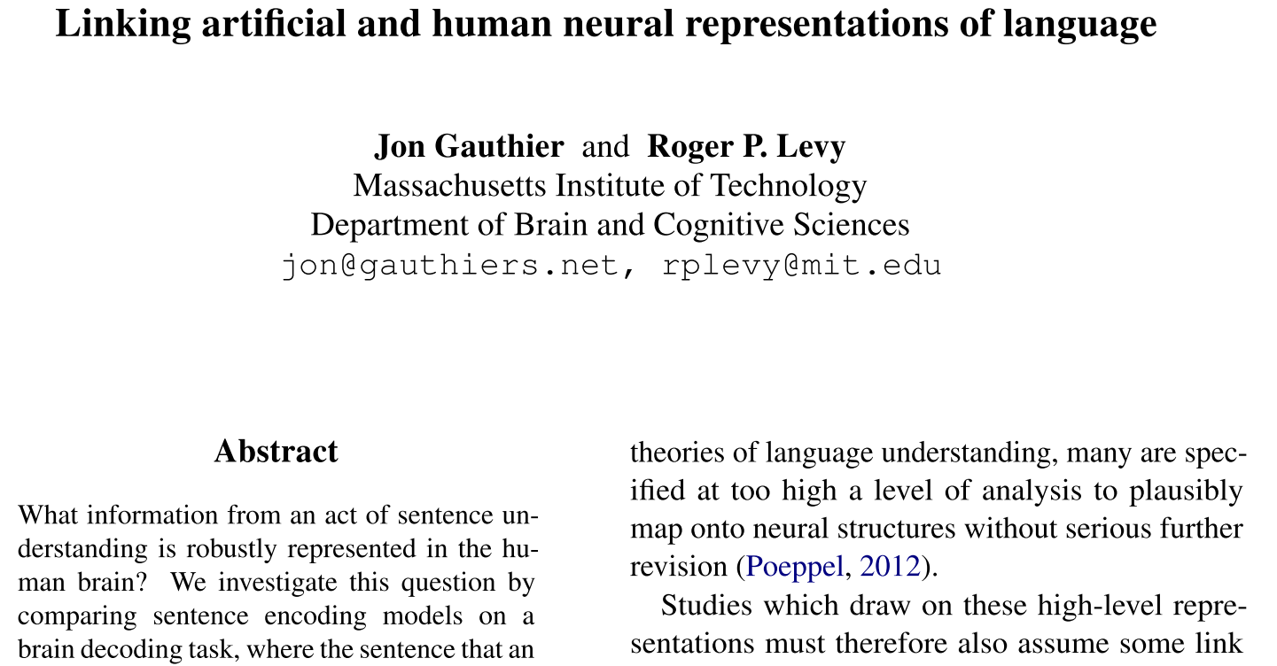
Brain encoding for single-mode stimuli: Text
Transformer language models
(BERT, XLM, GPT,…)
Vaswani et al. 2017, Gauthier et al. 2019, Schrimpf et al. 2021
Notes:
Therefore, the next logical step is to see which of these Transformer representations most effectively drive the linear mapping between language models and the brain in the context of NLP tasks.
Gauthier and Levy (2019) fine-tune a pretrained BERT model on multiple tasks to find tasks best correlated with high decoding performance.

Slide 10
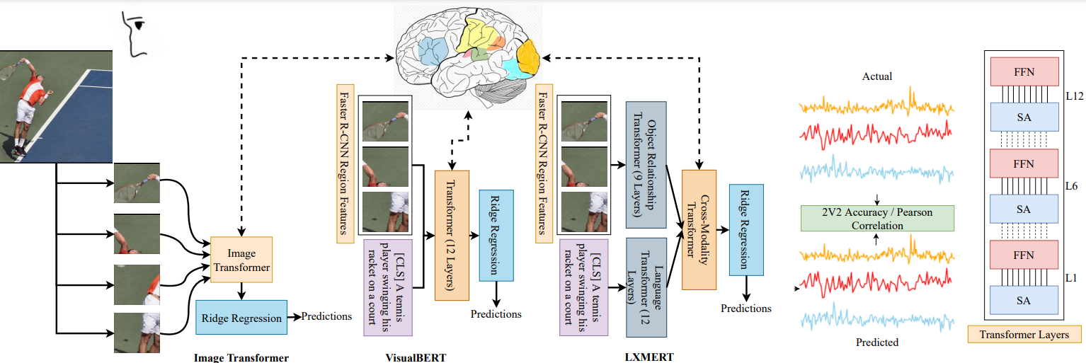
Can image-based and multi-model Transformers accurately perform fMRI encoding?
Dosovitskiy et al. 2021, Tan et al. 2019, Harold Li et al. 2019

Slide 11
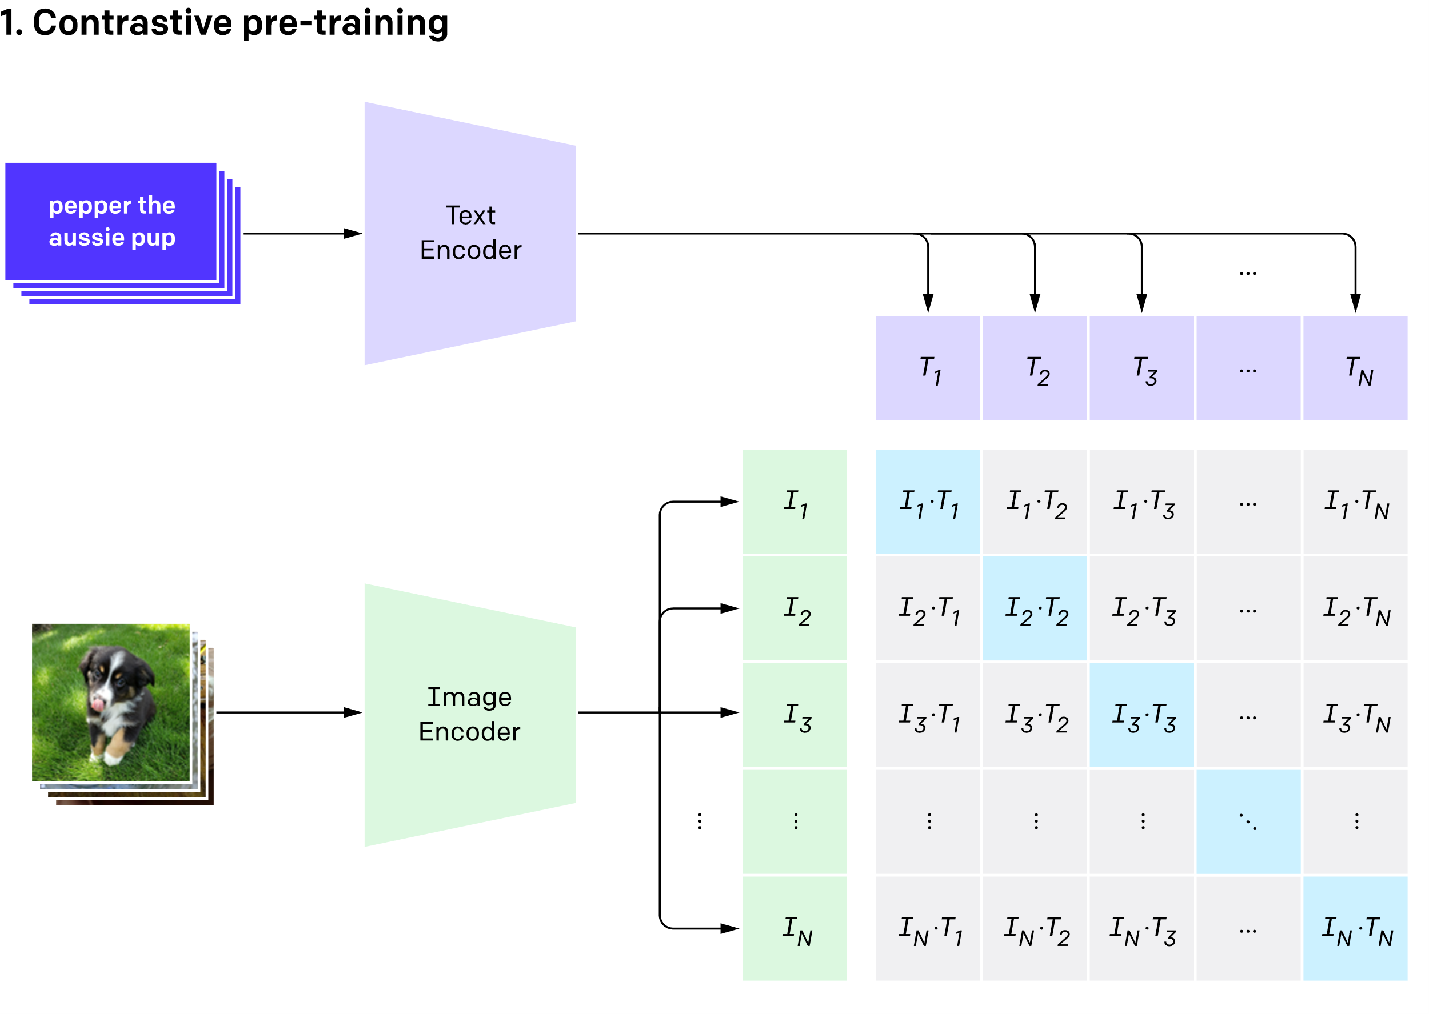
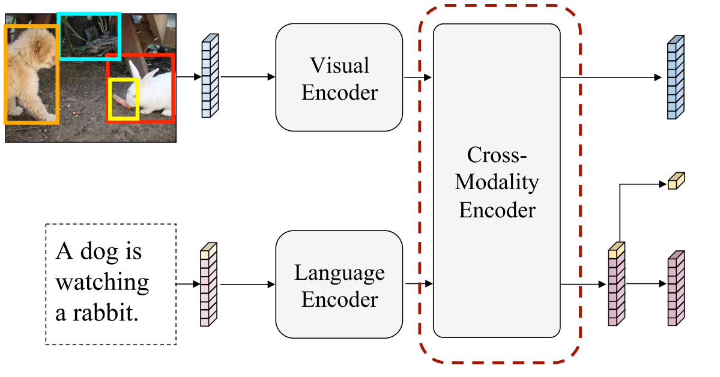
Models used: Multi-Modal Transformers
CLIP
LXMERT
VisualBERT
Radford et al. 2021, Tan et al. 2019, Harold Li et al. 2019

Slide 12
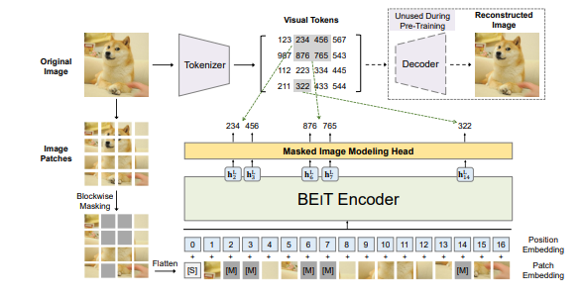
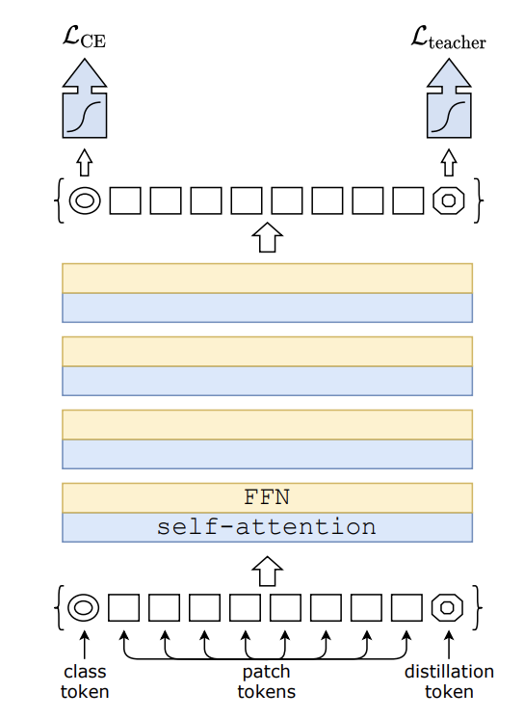
Models used: Image Transformers
ViT
BEiT
DEiT
Dosovitskiy et al. 2021, Hangbo et al. 2021, Touvron et al. 2021

Slide 13
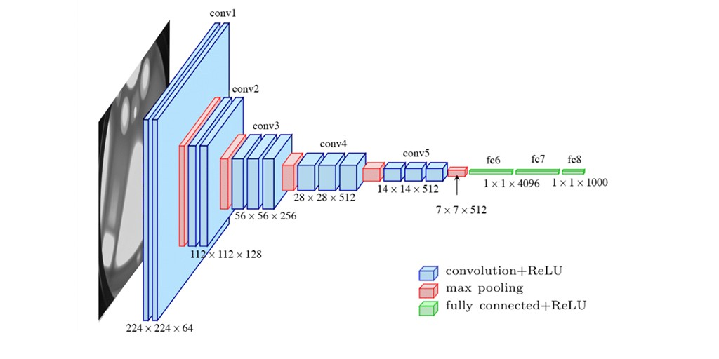
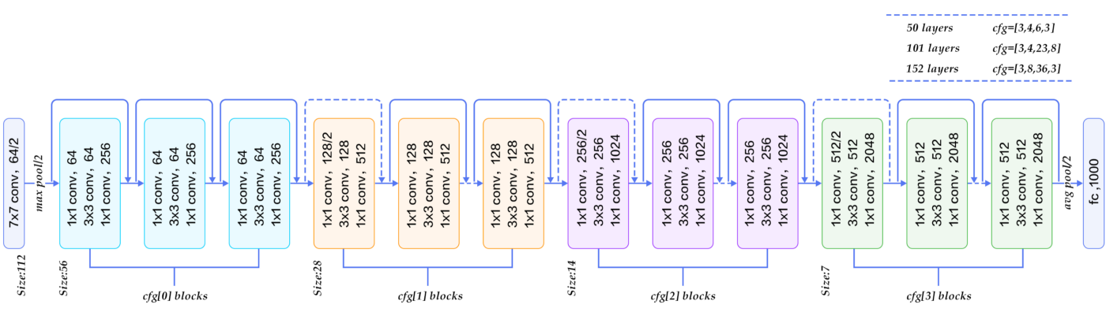
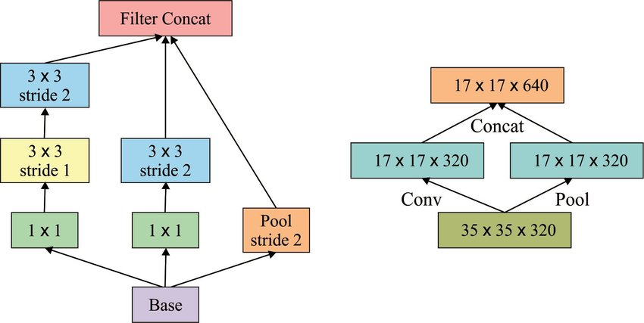
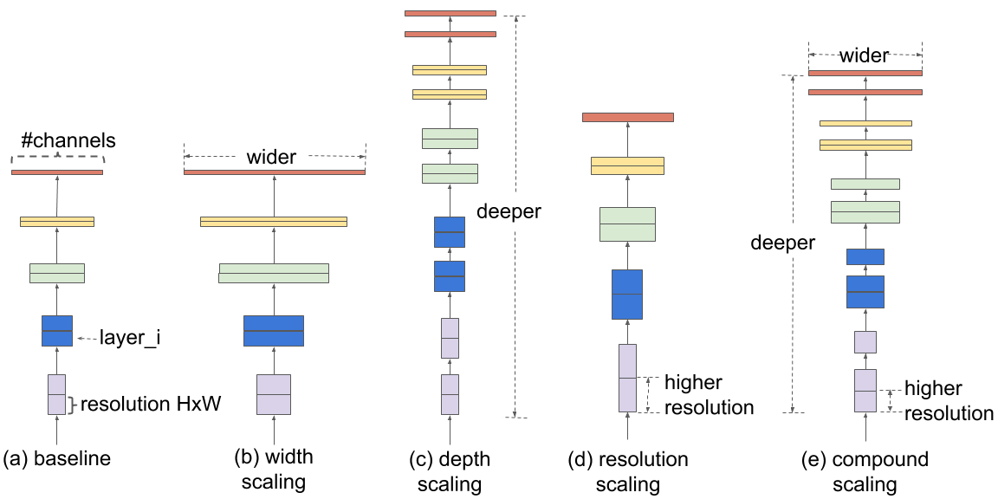
Models used: CNNs
VGGNET
RESNET50
InceptionV2
EfficientNET
Simonyan et al. 2014, He et al. 2016, Szegedy et al. 2017, Tan et 2019

Slide 14
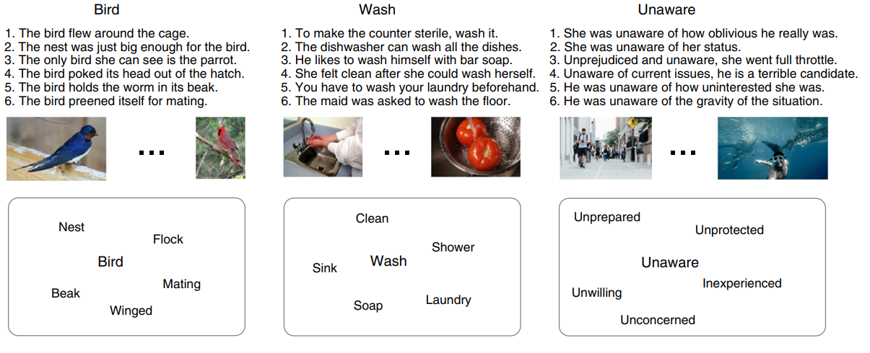
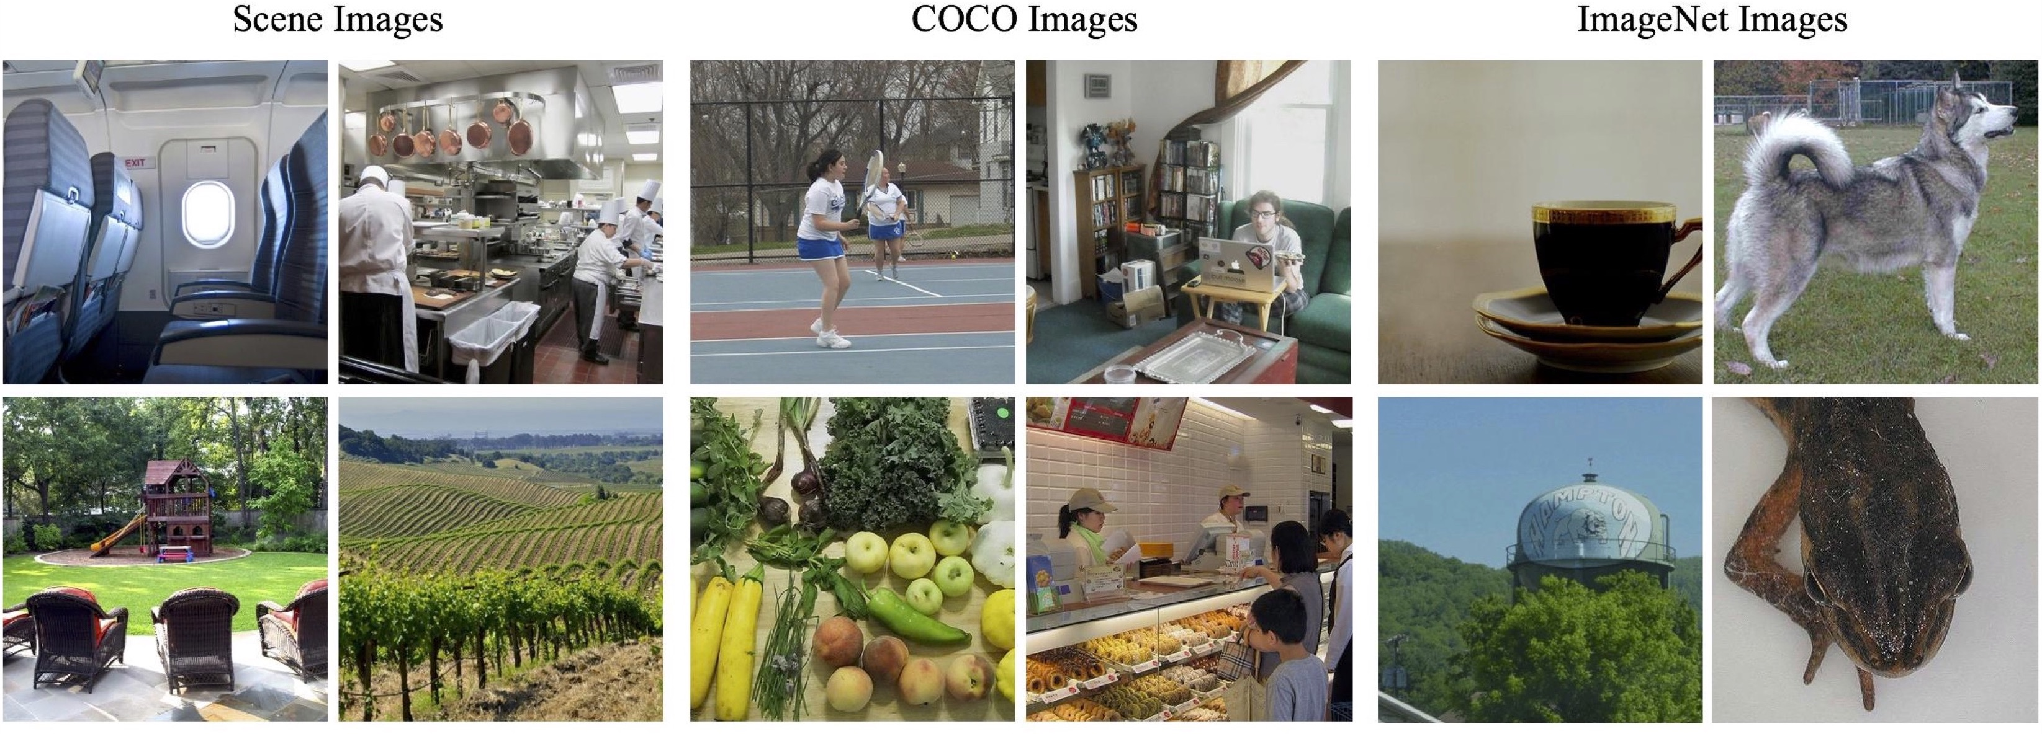
Dataset Details
Concept+Picture (Bird)
Periera
BOLD5000
Periera et al. 2018, Nadine et al. 2019

Slide 15
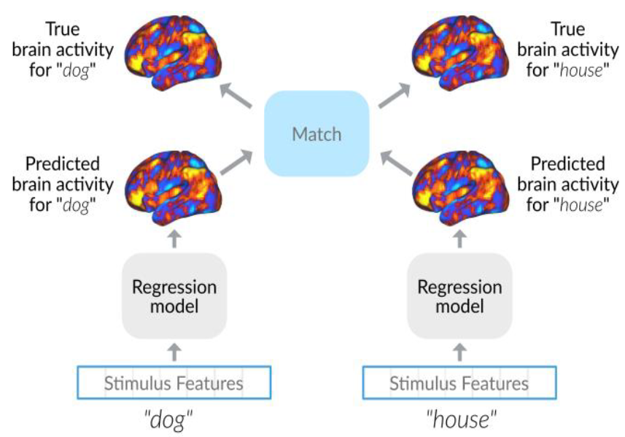
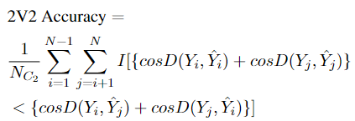
Evaluation Metrics: 2V2 and Pearson
Cosine distance
2V2 Accuracy
Toneva et al. 2020

Slide 16
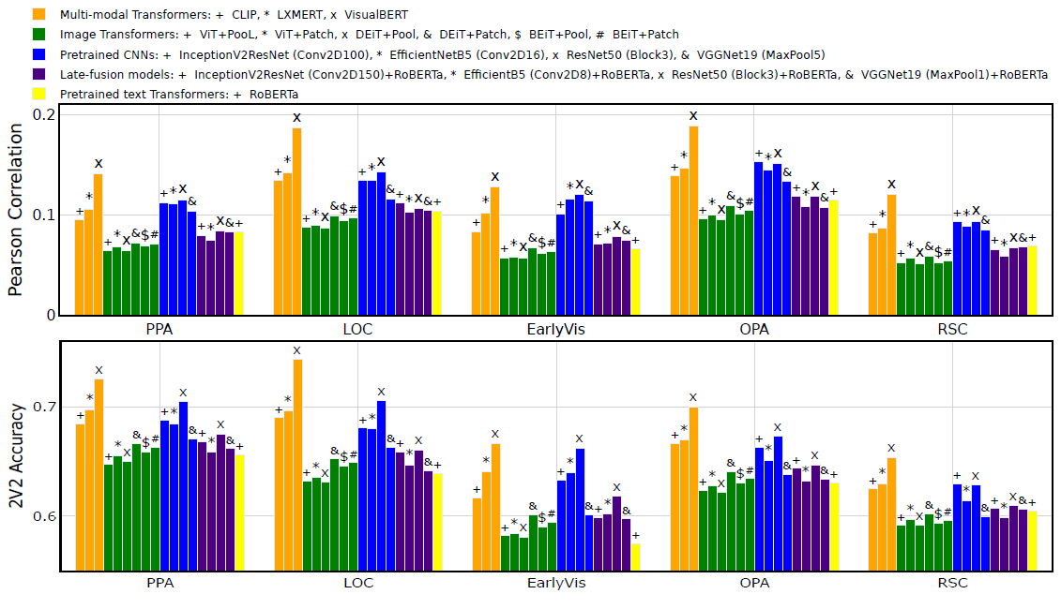
Encoding performance (BOLD5000)

Slide 17
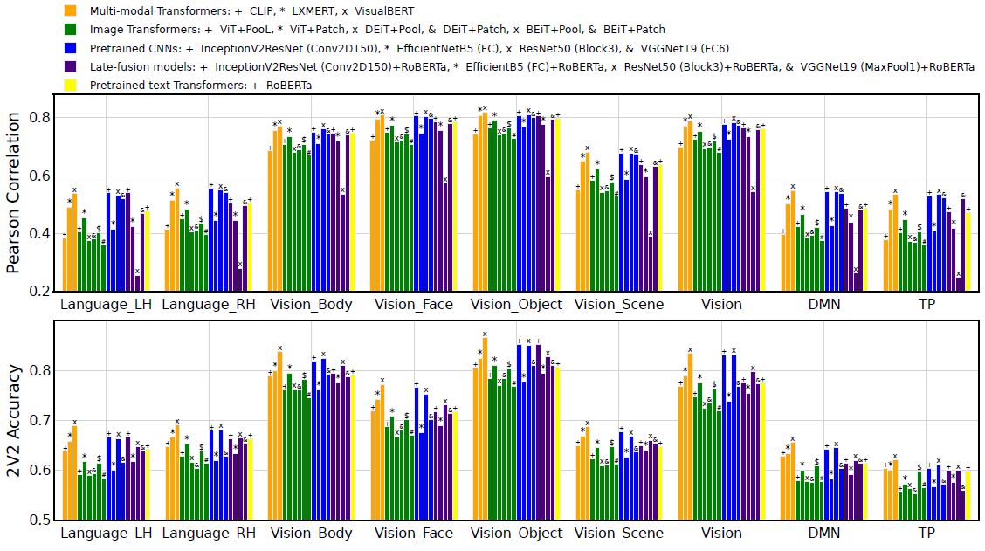
Encoding performance (Periera)

Slide 18
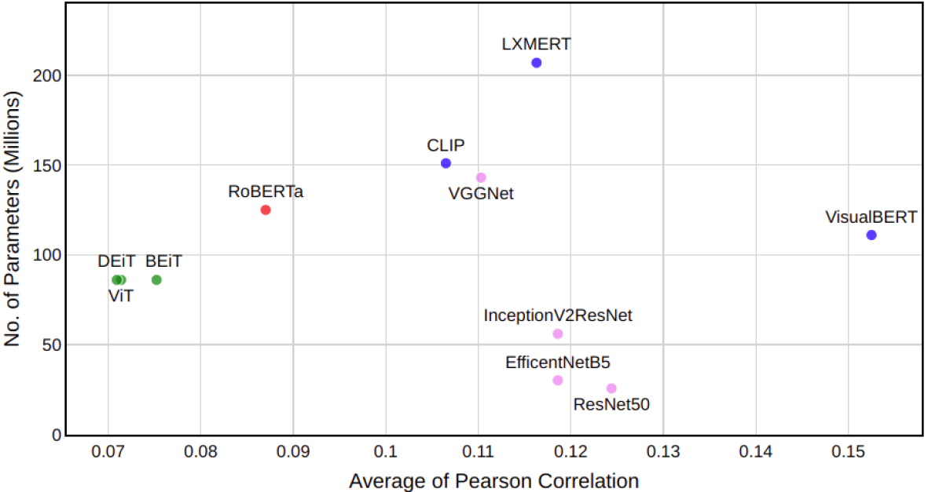
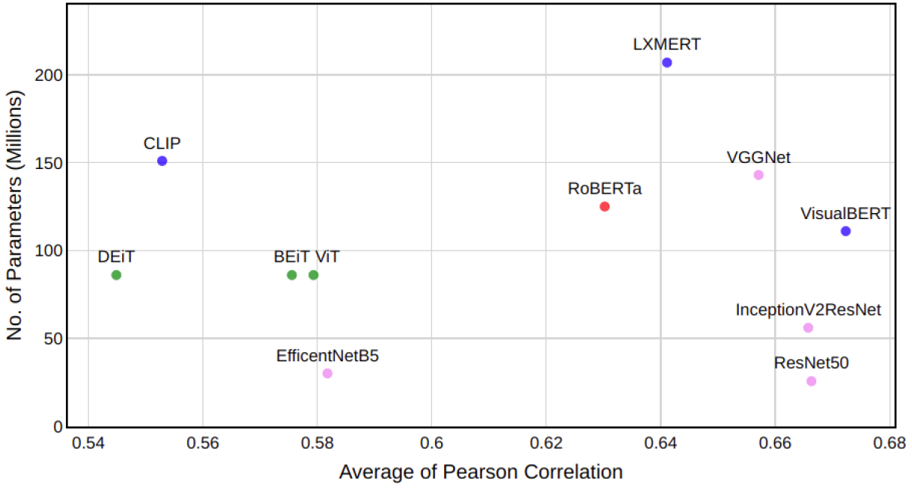
Model size vs Efficacy
BOLD5000
Periera

Slide 19
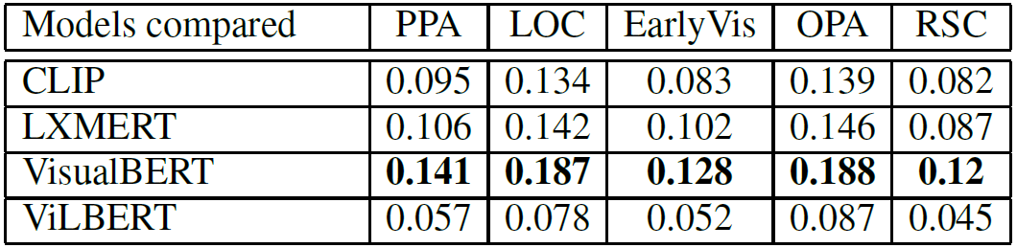
Single Stream vs Dual Stream
Dual Stream
Single Stream

Slide 20
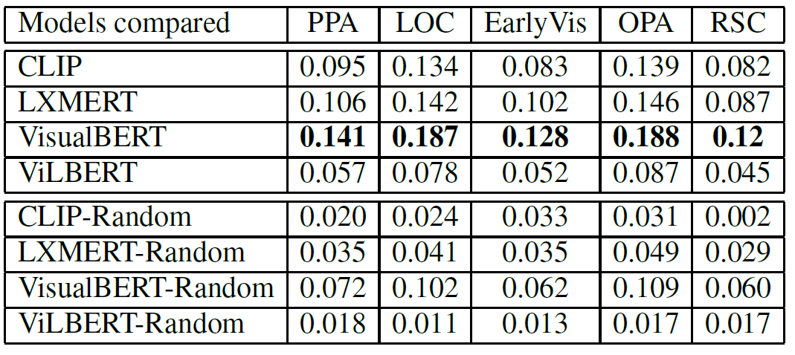
Is Linguistic Information Important in Multi-Modal Transformers?
Correct Image-Text pairs
Randomize Image-Text pairs

Slide 21
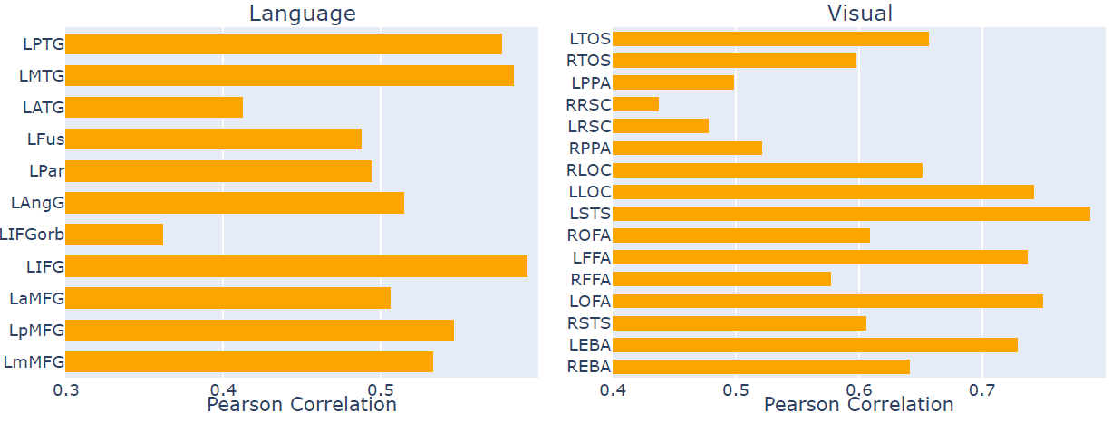
Does Language Influence Vision?

Slide 22





Collaborators
Subba Reddy Oota
Jashn Arora
Vijay Rowtula
Manish Gupta
Bapi Raju Surampudi

